Slide 1
New Hire On-boarding, Day 1 Systems & Tools Capgemini America Inc., Financial Services Strategic Business Unit
July 2019

Slide 2
FS SBU IT Policies
Information Security Policy
To promote a dependable and secure network environment for all FS SBU employees.
To encourage your responsible use of the technology resources which are made available to you.
To ensure the integrity, availability, and confidentiality of all information within FS SBU control.
Information Security Awareness and Orientation ecourse– Mandatory
Workstation Data storage Policy
Employees should store ALL FS SBU-related data in “OneDrive” or the appropriate “Project” or “Dept” folders. No personal data such as images, audio/video files, personal email, or any other non-FS SBU related data shall be stored on FS SBU systems.
Do not copy Capgemini data to unencrypted drives such as USB sticks, external hard drives, DropBox, Google Drive, etc.
Password Policy
You must change your password every 90 days. login to the corporate network, VPN, email, webmail. Do not share this ID and password with anyone.
Internet Access Policy
FS SBU employees are not permitted to use internet mails, messengers, download software from the internet unless authorized by FS SBU IT.

Slide 3
Log-in & Security: Password Requirements
Note that your password MUST follow these rules:
MUST have at least 8 characters
MUST use characters from three of the following four categories:
Uppercase characters (A through Z)
Lowercase characters (a through z)
Number (0 through 9)
Non-alphanumeric characters (!, $, #, %)
Your Windows ID and password are provided on an information sheet with the PC. In order to change the password, you must be connected to a Capgemini network within a Capgemini office (or logged in using VPN).
DON’Ts
Do NOT use common or proper nouns
Do NOT use your name or login name, even with digits
You CANNOT reuse one of your last 3 passwords
You CANNOT change a password which has been changed less than 1 day ago

Slide 4
Laptop: Hardware
You will receive the following items. If anything is missing, open a support ticket with IT to have the item sent to you.
Laptop
Laptop power adapter
Laptop bag
Network cable
Headset
Asset information sheet
There are two laptop types: sub-notebook and standard.
Laptop Replacement
PC Refresh – All employees are eligible for a new computer within a 4 year period (from hire date).
For a broken PC, the Group IT Service Desk will work with you to determine one of the following replacement options:
Hardware: Appropriate technician will be dispatched to replace the broken part if the PC if less than three years old.
Replacement of your faulty PC with a like-for-like model: The replacement PC will be shipped to you. Upon receiving your replacement PC, you must return the old PC within ten business days.

Slide 5
Laptop: Software
Please note
Security Software
Do not remove, tamper with, or interfere with the security software or you run the risk of losing data, infecting the Capgemini network, infecting a client network, or incurring hefty legal non-compliance fees for Capgemini.
Software will be updated/patched automatically by Group IT.
For additional software requests or software issues contact the Group IT Service Desk at 866-736-3399 or email IT Help.
Standard Software
Windows 10
Office 2013
Skype for Business
Internet Explorer
Cisco VPN
PDF Converter
Bitlocker (disk encryption)
Symantec Endpoint Protection (firewall, antivirus, and malware protection)

Slide 6
Log-in & Security: MobilePASS
To login to Capgemini resources remotely you need to use a password provided by the MobilePASS application
The MobilePASS soft token is a software application that can reside on a PC or mobile device. It generates a password which can be used to connect (authenticate) to the Capgemini network from a remote location, such as your home, a client site.
You can have up to 2 MobilePASS tokens active at a time. You can have for example one MobilePASS active on your laptop and another one on your mobile device.
Activate and begin using the MobilePASS soft token
MobilePASS site: http://selfportal.capgemini.com
Select the Activate MobilePASS Token link
Follow the instructions to activate your account
For additional setup assistance contact the Group IT Service Desk at 866-736-3399.
Notes:
Key Points:
Explain that this is for out of office use

Slide 7
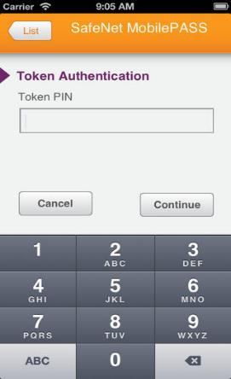
Log-in & Security: MobilePASS
Using the MobilePASS software token from a PC or mobile device
To generate a password using MobilePASS perform the following steps
Launch the application
Enter your 4 digit PIN
A 6 digit numeric password will be displayed
Use the generated password to login to VPN or website from the Internet
Notes:
Key Points:
Explain that this is for out of office use

Slide 8
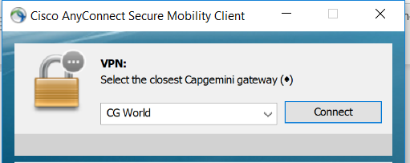
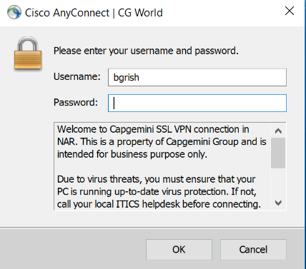

Log-in & Security: VPN
Run the Cisco AnyConnect Client
Click Connect
Enter your User ID
Enter the 6 digit password provided by MobilePASS
Click OK
Notes:
Key Points:
You need to do this for Outlook and access to the intranet when out of the office

Slide 9
Email
Email Systems
All FS New Hires use Exchange Online which can be accessed via the Outlook Web App
Webmail
Exchange Online https://outlook.office365.com
Enter the following:
Username: Email address (Firstname.Lastname@capgemini.com)
Password: Corporate password

Slide 10
Email: Mobile Devices
Set up email on your Mobile Phone
Contact the Global IT Service Desk to enable your mobile phone.
Self-enroll your device. Connect to http://byod.capgemini.com from your PC / laptop and enroll your mobile device. Open the Device Enrollment Guide for step-by-step instructions through the enrollment process. You will receive an email with additional instructions once you enroll your device.
Install the Good Work apps. If you are using an iOS or Android device, download the Good Work and Good Access applications from your regular application store.
Activate Good Work and get familiar with features. Follow the steps in the Good Work Quick Start Guide for iOS or Android for fast and easy setup. You can start using Good Work right away. Good Work includes many features that make it easier to get work done.
Refer to BYOD Policy and other information documents published on Talent
Set up Office Wireless on your Mobile Phone
The Capgemini Office Wireless (XS4Mobile) is available for phones and tablets using iOS and Android. To activate, follow the steps below:
From a Capgemini office, browse to the link below using your mobile device: https://mymobile.capgemini.com/
Sign in with your Corporate Login ID and Safeword/MobilePASS password
Select the ‘Configure XS4Mobile’ button and follow the on-screen prompts
Upon activating the service, your device will automatically join the XS4Mobile network each time you visit a Capgemini office where the service is available.

Slide 11
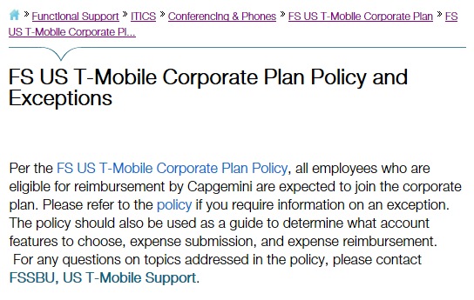
Mobile Corporate Plan
Corporate mobile plan provided by T-Mobile. This plan will be available to FS US employees who are eligible for reimbursement by Capgemini per this policy. Note: The T-Mobile invoice is linked to employee’s corporate AMEX card which makes billing easy to manage.
The policy associated with the corporate mobile plan is accessible on an FS US–specific section of NAR Talent. Access it here. https://talent.capgemini.com/nar/pages/functional_support/Group_IT_Americas/mobile_devices__plans/us_corporate_mobile_plan_fs_employees/
If you have questions regarding the plan and related policy for FS North America, please send email to: FSSBU, US T-Mobile Support [ ust-mobilesupport.fssbu@capgemini.com ].

Slide 12
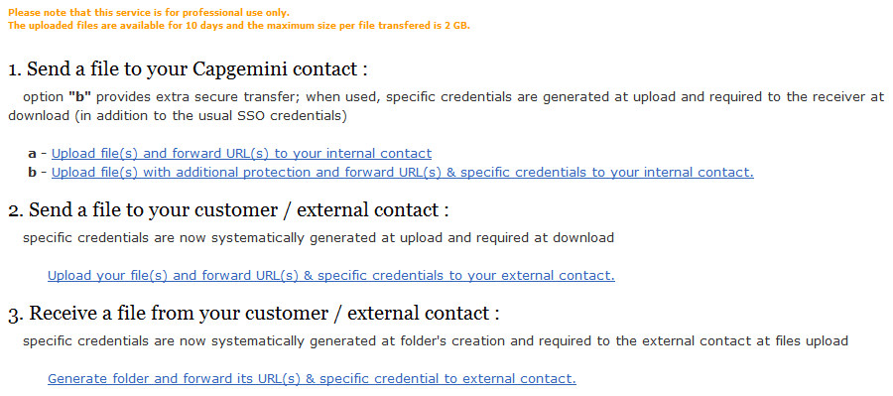
File Transfer Service (FTS)
File Transfer Service is designed to send/receive large files (2 GB max) to colleagues or to an external customer
You can also create a link for an external customer to upload documents
FTS URL: http://fts.capgemini.com
Notes:
Key Points:
Our email limit is 10MB per message and our clients often have even stricter limits
FTS is useful for sharing large sized deliverables

Slide 13
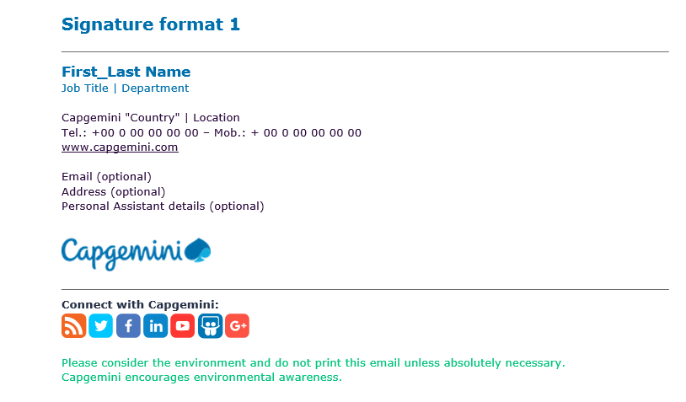
Email: Signature
Be a Capgemini brand ambassador and display the updated Group email signature.
Email signature a mini ad with every email
Every employee, as Capgemini ambassadors, can support the brand with each email sent.
You can download the signature template from the Capgemini Visual Identity site or simply copy it from a coworkers email and update with your details.
https://visualidentity.capgemini.com/digital-assets/email-signature/
Here’s a sample of how the email signature should look:
Notes:
Key Points:
Facilitator should have everyone try this and set it up with their local office address

Slide 14
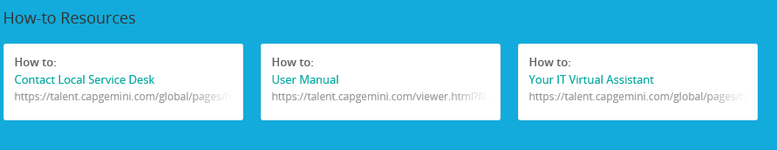
Service Desk
Contacting the Global IT Service Desk
Portal: http://help.capgemini.com
Phone: 866-736-3399
On the desktop of your PC, you may also find a Group IT Help folder. This is also another source that can provide helpful information and instructions for various topics.
VPN
MobilePASS
Password
Skype

Slide 15
Ordering Business Cards
Objective: To order your business cards
Instructions:
If ordering for Canada, visit https://platinum.tph.ca/capgemini/usercontentstart.aspx and log into the site
If ordering for US, http://www.capgeminicc.cgconverge.com/
First time users are required to register themselves first.
Choose Browse Products → Business Cards and select CAPCN0 Capgemini Business Cards (this is the standard FS GBU Card)
Click Order Item
Choose your quantity and shipping method, and then personalize your card by entering all relevant details into the form
A preview of your card is available on screen to ensure accuracy
Once your card is finalized, click Approve → Save to Basket → Checkout
Note: The site allows for multiple orders in a single transaction
Review the contents of your Basket and provide your shipping and contact and payment details
Once you have entered your details, click Place Order.
You must also click to agree that your information is correct and accurate
No changes are allowed once an order is submitted
A confirmation email will be sent to you for shipment tracking purposes.
You can claim your expenses in the expense tool for reimbursement.

Slide 16
Facilities: Hoteling Process
System
Reservation
Check In
OnBoard Hoteling Reservation is available to all North America employees to reserve workspace and conference rooms for any of our North America offices**
http://hoteling.nar.capgemini.com
**This is not applicable to the Charlotte offices
Log into the On-Board site to make a reservation
After making a reservation, you will see it listed on the OnBoard home page and you will receive a confirmation email
Under Reservations / Manage Your Own, you can see all your reservations to cancel or modify as necessary
Reservations can be made up to 30 days in advance for a workstation; 17 days in advance for an office; 60 days in advance for a conference room
Only one workspace reservation can be made for a given time
You will need to check in within 3 hours of your daily reservation in order to keep your room/workstation and phone reservation in place for the day
Schedules change, so having everyone check in daily will ensure any space that is not being used will become available
Two check-in options:
Via the web, your reservations will be listed — under Actions, click on Check in
Via phone, if you have set up a PIN, you can check in using the Services menu
Notes:
Key Points:
Try to reserve a room for Thursday at your local office
Friday’s are usually busiest → book early

Slide 17
FS SBU Tools can be found on iConnect
Understanding the Capgemini Systems and Tools
iConnect
Clarity
Time-Sheets
Egencia
FS SBU Talent Page
Leave Management System
Knowledge Management
IT Help Desk
Notes:
Key Points:
We will now get familiar with some of the standard tools used internally

Slide 18
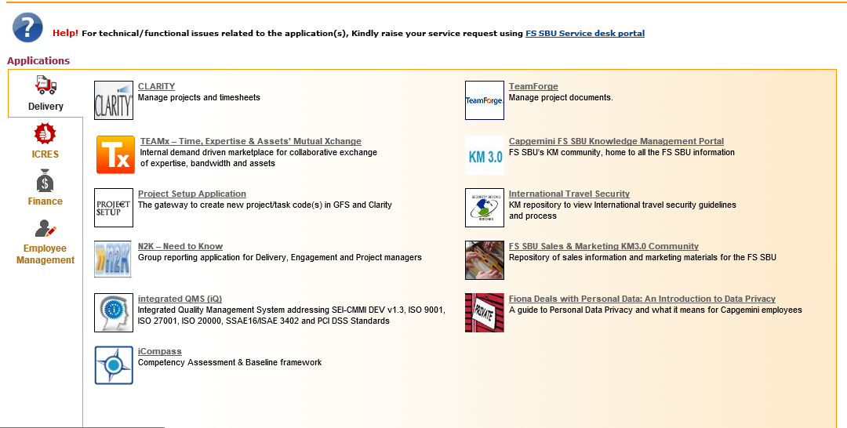
iConnect
The iConnect site is a portal with links to all the FS applications
Use the tabs on the left to view different categories
iConnect URL: https://iconnect.fs.capgemini.com

Slide 19
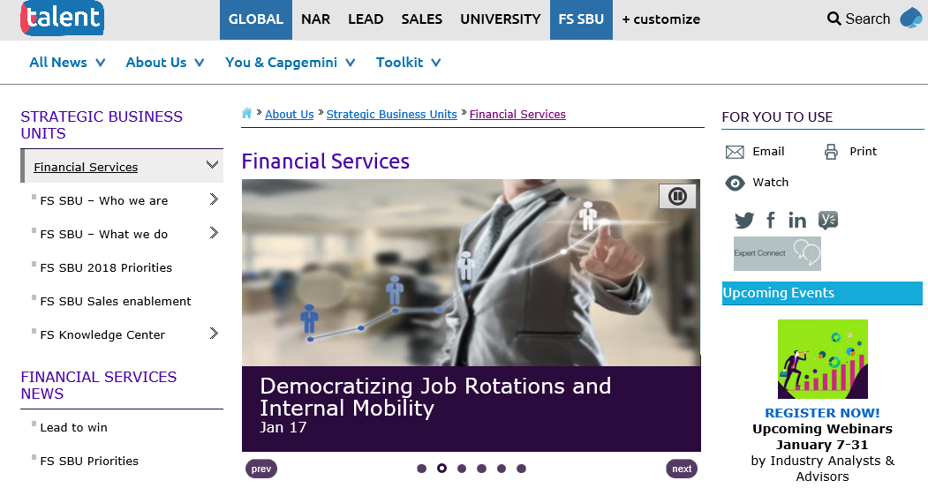
Talent
Talent main URL: http://talent.capgemini.com
Financial Services URL: http://talent.capgemini.com/global/pages/hubs/strategic_business_units/financial_services/

Slide 20
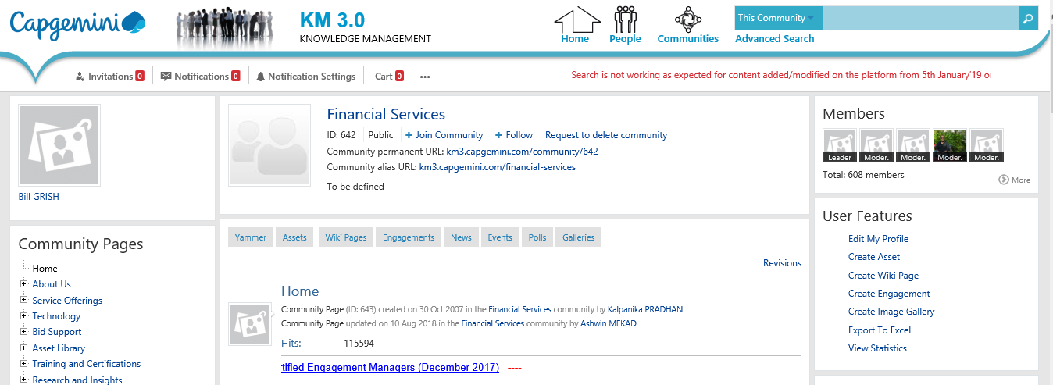
Knowledge Management (KM)
The KM3 Global Community has been designed to help you navigate global content structured along industries or sectors, service lines or offerings, software or products, enabling functions, and certification communities
Main URL: https://km3.capgemini.com/
Notes:
Key Points:
Most of all collateral is here
Make sure you check “ search all KM community”
Some files are protected with owners who need to give permission
Facilitator should make sure to join the community above, so it shows up on their home page
We also use Yammer across the enterprise, and there are Capgemini blogs aplenty
Exercise (if time permits):
Go to the left-hand pane and click on Financial Services
Make sure you have already joined (http://km20.capgemini.com/community/642)
On the FS Home Page show them where the important links are, practices, DEG, FS WinCenter, Sales, people Care, Finance…
Our Global CTO’s Technology Blog: http://www.capgemini.com/ctoblog/
Looks like a lot of knowledge, how do you manage all of this? Use MyDesk! http://talent.capgemini.com/mydesk/

Slide 21
Travel: Introduction
Travel Provider: Egencia Travel
1-877-232-4956
The non toll free number is 1-949-930-9519
7am to 7pm CST Monday thru Friday
www.egencia.com
If you have any questions regarding travel please contact Ilona Bereckis at 847-384-6156 or ilona.vida@capgemini.com
If your name is incorrect within Egencia, you are able to change your name within 30 days.
If Egencia requires a travel approval please have your people manager or project manager approve your trip.
For questions and reservations regarding travel within India please fill out the India Travel Request Form on the applications page of iConnect. To contact the team at India offices for any specific questions regarding travel please email DL FSSBU – India Travel Group
Notes:
Key Points:
We use Egencia for all travel bookings
Built in travel discounts have been negotiated
Don’t use Kayak, Priceline, ect.
You will still get all frequent flier miles

Slide 22
Travel: How to Book
Prior to travelling, complete your profile with Egencia
Capgemini employees will access Egencia via SSO. To access the Egencia home page, go to:
US: http://capgeminifs.egencia.com
Canada: http://capgeminica.egencia.com
For your convenience, please remember to add this link to your favorites on your browser.
Travel arrangements avail via Egencia includes flights, hotels, rental cars, and train reservations
Egencia requires that your Corporate AMEX card be used to book all travel arrangements.
Please ensure that all business travel accommodations are booked through Egencia. If you cannot reach the Egencia site, you can book travel through an Egencia agent at 1-877- 232-4956 (U.S. based employees) and 1-866-255-5165 (Canada based employees)
If you have any questions or issues regarding Egencia, please contact Ilona Bereckis at Ilona.vida@capgemini.com.
Notes:
Key Points:
Setting up your profile will accelerate your future bookings

Slide 23
Travel: Policy (US / Canada)
Type of Travel | Policy | Preferred | Additional Notes
Air | Economy class tickets Book the least expensive, non-refundable fare 14-day advance purchase is required Egencia receipt is required for reimbursement (Egencia receipt is available online 24 hours after booking a trip for up to 90 days) | N/A | Any Frequent Flyer miles or upgrades earned goes to the employee If you can not make your flight, you must cancel prior to departure or the ticket has no value. The ticket will not be reimbursed by Capgemini if you fail to cancel
Rental Car | To be reimbursed you must book the car rental via Egencia Booking a car with another rental company will not be reimbursed Mid-sized or full size (when needed) is the standard size DO NOT choose the pre-pay fuel option Insurance Coverage is included with all Avis and Budget rates | Avis is the primary vendor, http://www.avis.com/car-rental/avisHome/home.ac Budget is the secondary vendor, http://www.budgetcarrental.com/budget/fastbreak/index.html?T342500 | If an accident occurs please contact the number on your rental agreement with the car rental company
Notes:
Key Points:
Ideally look for the cheapest flights with the least amount of layovers
Rental car(s) should be shared as much as possible
Aim to carpool (2 or more)
The 25 year old age restriction is waived for Capgemini bookings

Slide 24
Travel: Rental Car
The Avis Preferred Service program provides rate savings, compliance, the ability to bypass the rental counter, and go straight your pre-assigned rental vehicle.
All business travelers should sign up for Avis Preferred Service if not already a member by completing a brief on-line application which is available by clicking the below link to enroll today
Preferred Service includes the opportunity to bypass the Avis rental counter in addition to many benefits as listed above
Upon completion of the enrollment application, the site will auto-return to you your new Avis Preferred Wizard number
Click here to Enroll in Preferred Service Today: https://www.avis.com/car-rental/profile/go.ac?A603800
Personal or vacations Avis rentals for Capgemini click here: https://www.avis.com/car-rental/profile/go.ac?A603890
If you currently possess an Avis Preferred Wizard Number, please go to http://www.avis.com and click on “Register Now” for MyAvis to ensure your Avis Wizard Number includes the correct Avis Worldwide Discount (AWD) Number A603800 for your Capgemini rentals
You may reach an Avis Customer Service Representative at 1-866-842-5552 then press 2. Please have your Avis Wizard # available.
Sign up for Budget Fastbreak Service to ensure expedited services by completing a brief on-line application which is available at http://www.budgetcarrental.com/budget/fastbreak/index.html?T342500
If you currently possess a Budget Fastbreak number, it is not necessary to complete the application, but you do need to ensure your profile has the accurate Capgemini Discount Number T342500, credit card information, driver's license, and e-mail address in order to receive E-receipts
Personal or Vacation Rentals with Budget click here: http://www.budgetcarrental.com/budget/fastbreak/index.html?T342590
Notes:
Key Points:
Setting up your profile will accelerate your future bookings

Slide 25
Travel: Policy (US / Canada) (cont.)
Type of Travel | Policy |  | Additional Notes
Accommodations | Egencia online tool has all hotels that offer Capgemini discounts loaded in their system “No-show” charges are the employee’s responsibility Itemized hotel receipt required for reimbursement |  | Be sure to collect all receipts for your business travel
Meals | Detailed receipts are required for all meal purchases Detailed reimbursement amounts shown on next slide |  | N/A
Transportation | Free shuttle service from Rosemont office to O’Hare Call 847-318-0554 to arrange transportation Many major hotels offer free shuttle service When using personal vehicle, either gas or an amount per mile will be reimbursed In the US, the amount is 54¢/mile (USD) per IRS regulations |  | If leaving your car overnight in the Rosemont office parking lot you MUST fill out an “overnight parking form” and submit it to the building security guard to avoid your car being towed. Obtain the form in the mailrooms of the Rosemont office
Notes:
Key Points:
Save receipts
Sign up for hotel and airline loyalty programs → great personal benefit from travel
If meals are more then $60, you can cover the remaining amount of pocket
NY has higher limits and other places have lower limits
Verify with Project Manager

Slide 26
Travel: Policy (US) (cont.)
Austin $60 $225
Chicago $60 $225
Houston $60 $225
Jersey City $60 $230
Los Angeles $60 $225
Newark $60 $225
New York $60 $365
San Francisco-
Bay Airport $60 $225
San Francisco-
Downtown $60 $290
Other US Cities $60 $150
Meals (per person) Hotel (incl. breakfast)

Slide 27
American Express Corporate Card
For business use only
No annual fee for cardholders
Required for all business transactions – required for all Egencia transactions
Employee is personally liable and responsible for paying the bill on time
Monthly monitoring
To apply please go to www.americanexpress.com/applyforcard and type in the access key code of j6v3ipib
Card usually arrives in 7-10 business days
Rush is available for $15 Fee (can be expensed if required using the charge code you will be provided at the end of your Onboarding class)
No SSN? Please check box for non-US Citizen and put a future date of when you will depart the US (Must be at least 90 days from application date)
Please abbreviate address as much as possible if space is not big enough (i.e. 123 Main Street Apartment 456 can be 123 Mn St #456)
Use CAPGEMINI email for statements
Enter Employee ID (Provided to you by HR)
To Sync card up with Concur email naac.teinquiry.in@capgemini.com with card number and country (I.E. US or Canada) along with Full Name on the AMEX Card
Notes:
Key Points:
There is no spending limit, but pay it on-time as it will affect your credit
You can manage/pay online
Platinum AMEX card gets you airport lounges and free companion tickets

Slide 28
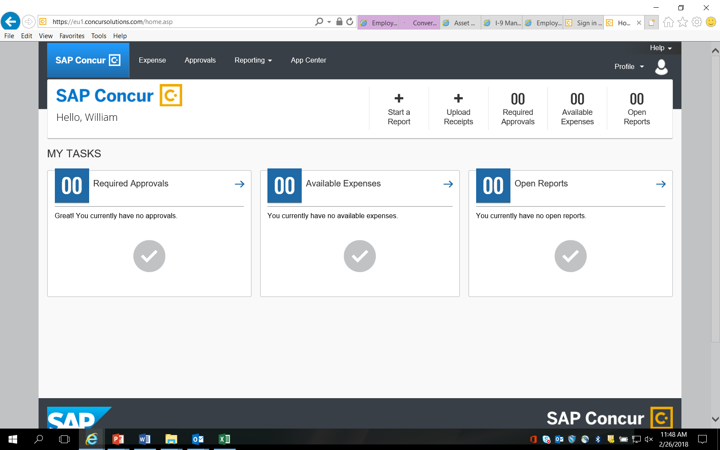
Expense Tool
Click Start a Report to begin the process.

Slide 29
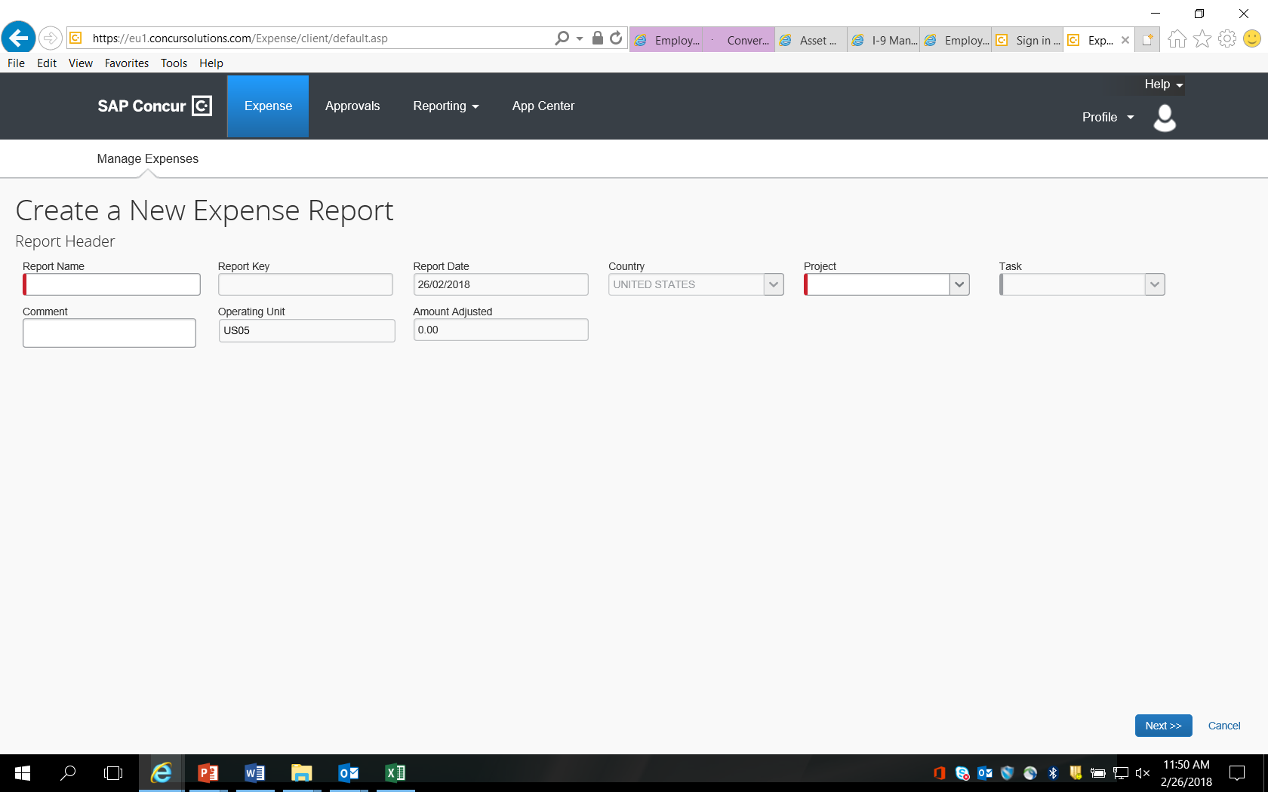
Expense Tool(cont)
Enter the project number given to you by your team lead.

Slide 30
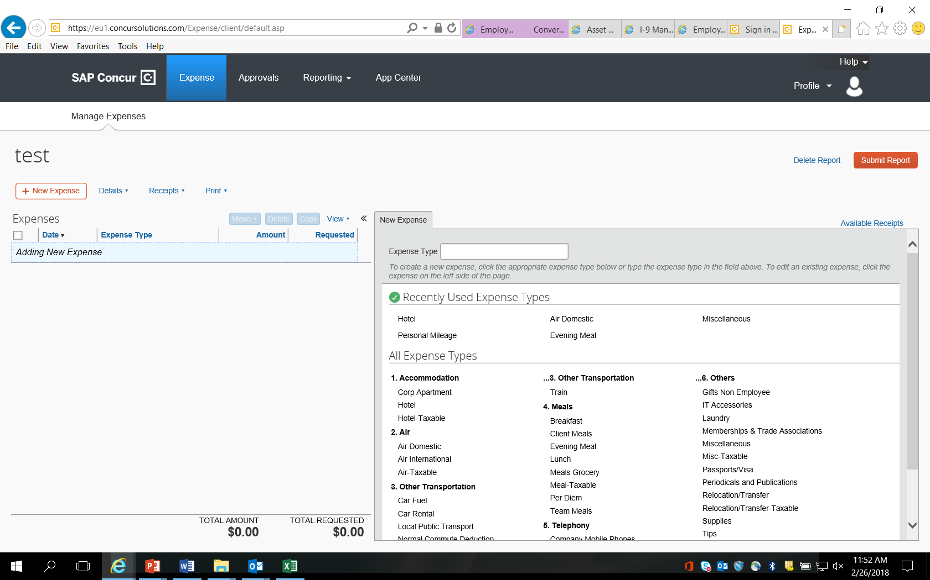
Expense Tool(cont)
Select expense type and start building your expense report.

Slide 31
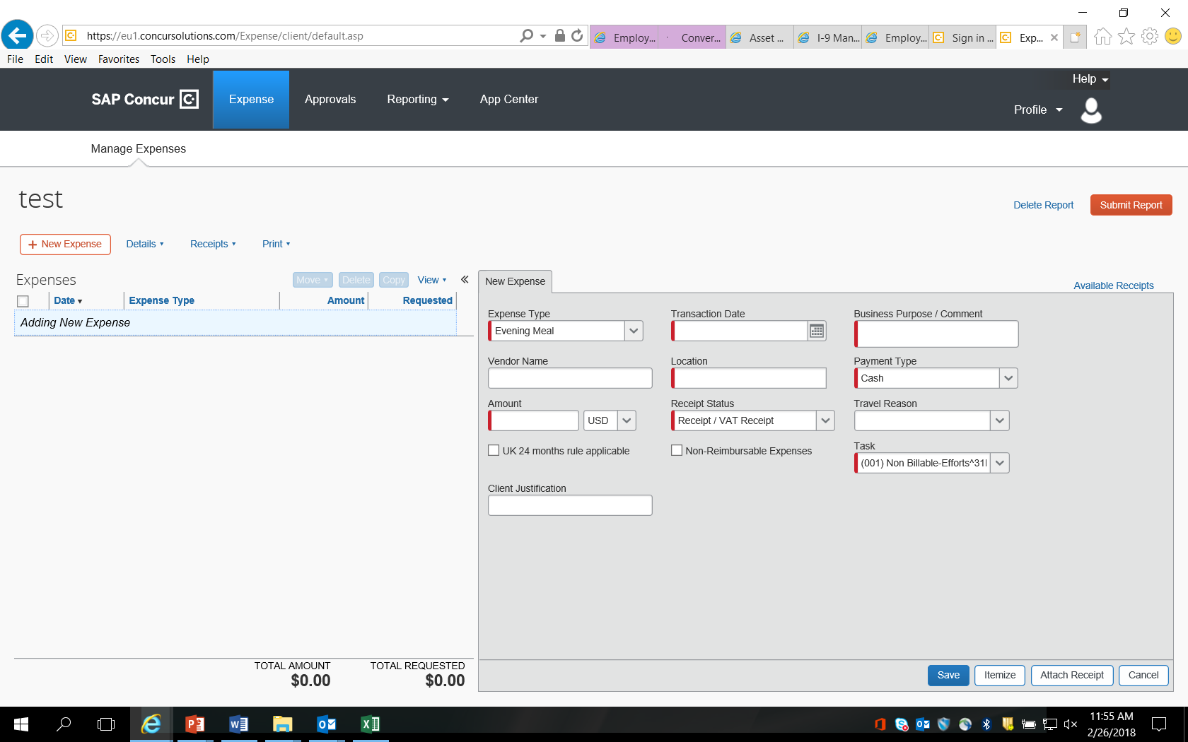
Expense Tool(cont)
Example for evening meal reimbursement shows here.

Slide 32
Expense Tool(cont)
Fill in all the fields marked in “red” on left

Slide 33
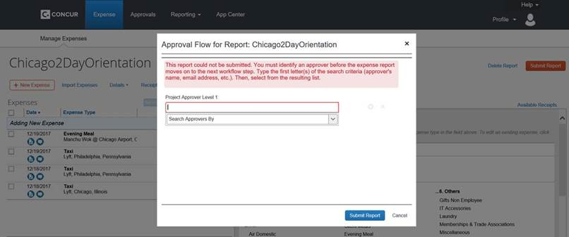
Our Concur expense tool is used for reimbursement – more info on the expense tool is provided in email 1 of 3 from your onboarding class
Short-cut: In order to find a list of approvers for any given charge code, please enter * when you come to the Concur screen shown below.
All expenses are entered online via the Expense website
Login ID and Password – Same as Capgemini FS SBU login credentials
Notes:
Key Points:
Try the spreadsheet import
Complete as early as possible as processing expenses takes time (usually 2 to 3 week cycle) and you may find yourself paying out of pocket

Slide 34

Expense Tool(cont)
The last step after completing all of your entries and attaching receipts when required is to “submit report”.

Slide 35
Time Entry Process & Expectations
Time entry is a critical component to our business and it is everyone’s responsibility to ensure it is completed accurately, and timely….
Time sheets are opened and available to everyone the first week of each month
In FS we expect that everyone enters their time at minimum weekly!
Adherence to this process is a fundamental KPI for everyone in FS
All time for a month should be entered and approved by the 3rd Friday – this means some time is entered prospectively given your current knowledge of your schedule
Time can be adjusted, if needed, afterwards if a sick day were to come up for example
When time is adjusted through the Leave Management System affected timesheets that have been already submitted must be reviewed by the individual and resubmitted in Clarity
Failing to enter time within these timeframes results in…
Inaccurate or delayed revenue recognition;
Inaccuracies and/or delays in Client invoices;
Incomplete information for Project Managers making staffing decisions; etc.

Slide 36
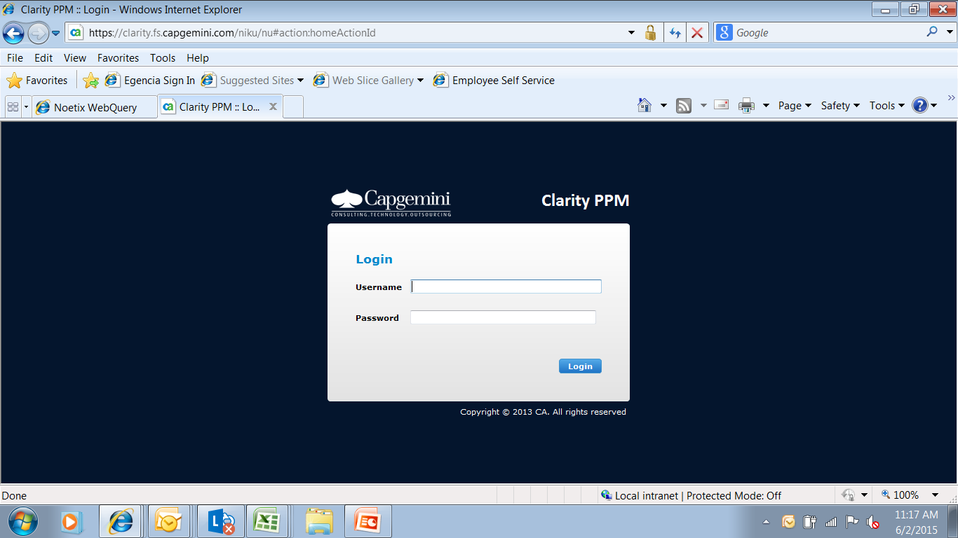
Timesheet Entry on Clarity
1) Log onto Clarity as follows:
a) Access the site: https://clarity.fs.capgemini.com
b) Login to using your Capgemini FS User ID and Password

Slide 37
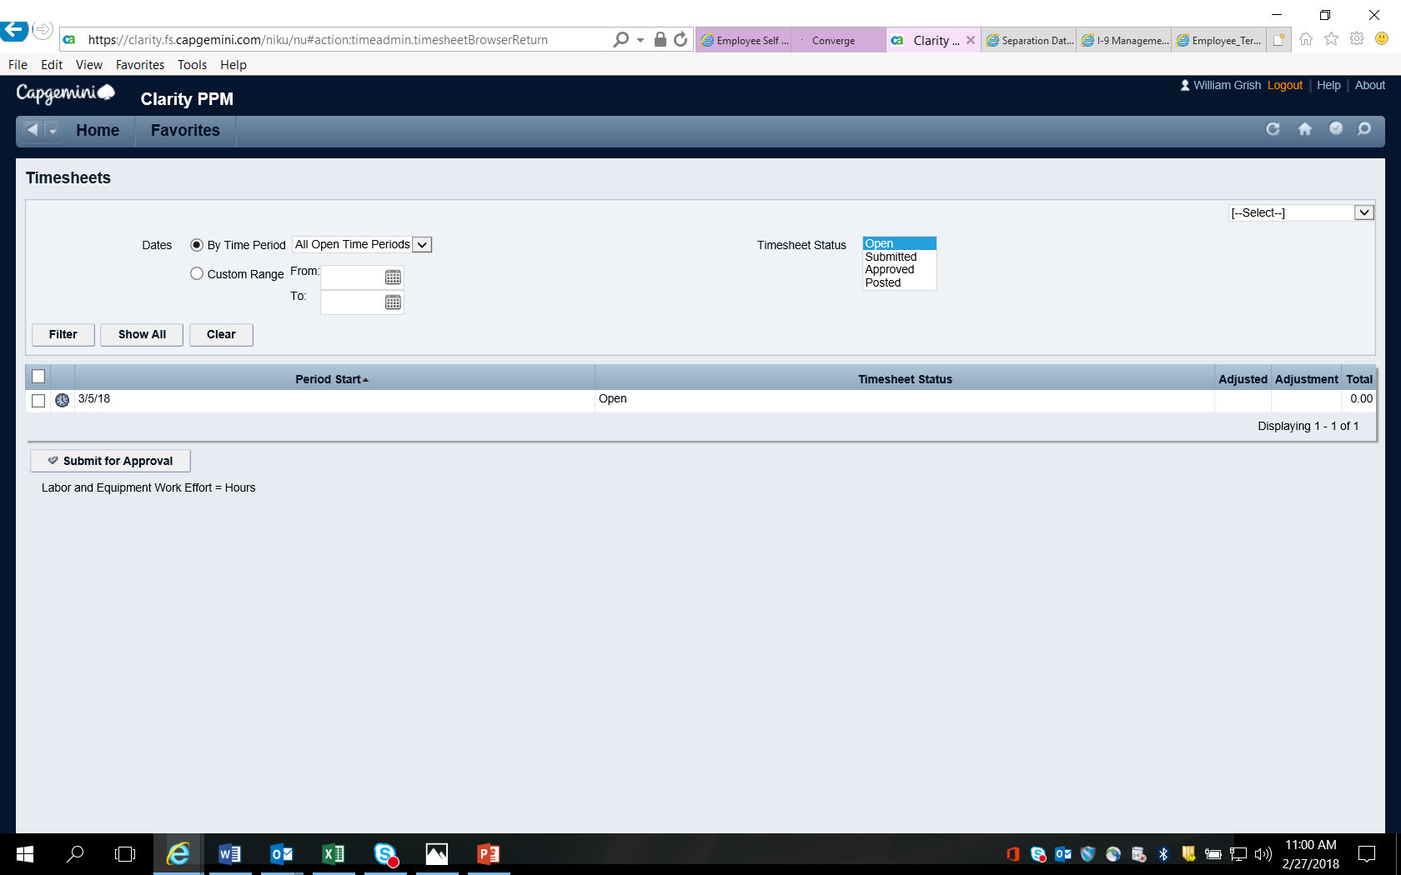
Timesheet Entry on Clarity (cont)
Click on the Clock Icon to view the timecard for the specific time of the week.

Slide 38
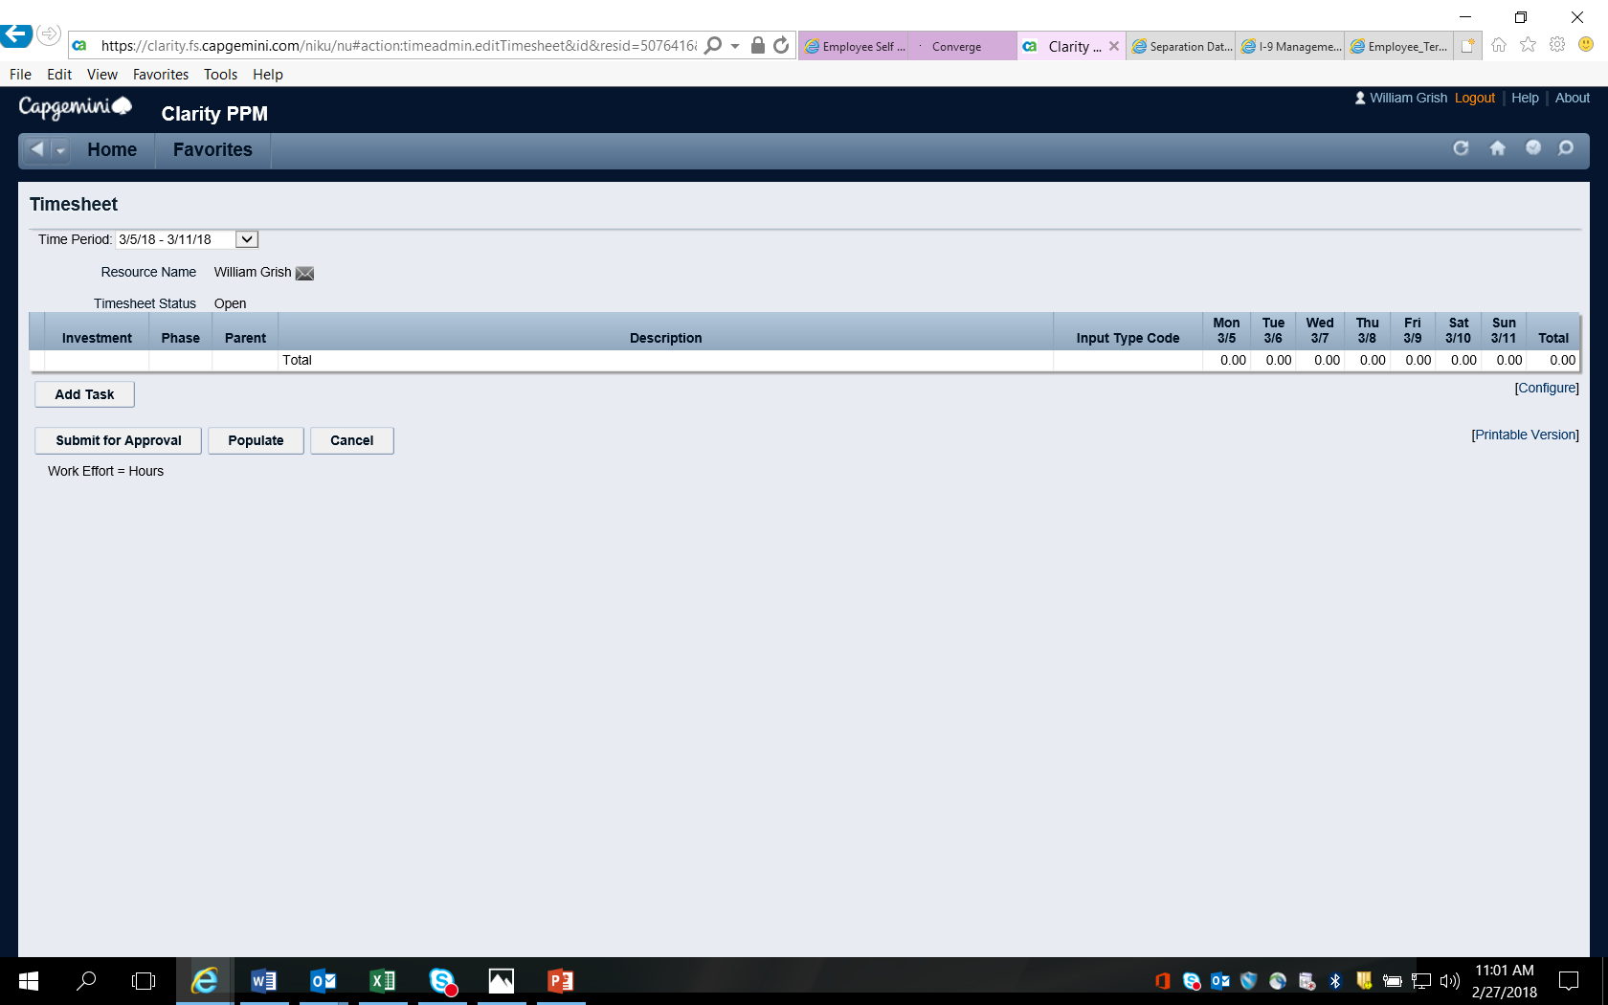
Timesheet Entry on Clarity (cont)
Click on Add Task for the list of tasks. If the ‘Add Task’ doesn’t appear, it means that you were not allocated to project. Please contact your Staffing Partner.

Slide 39
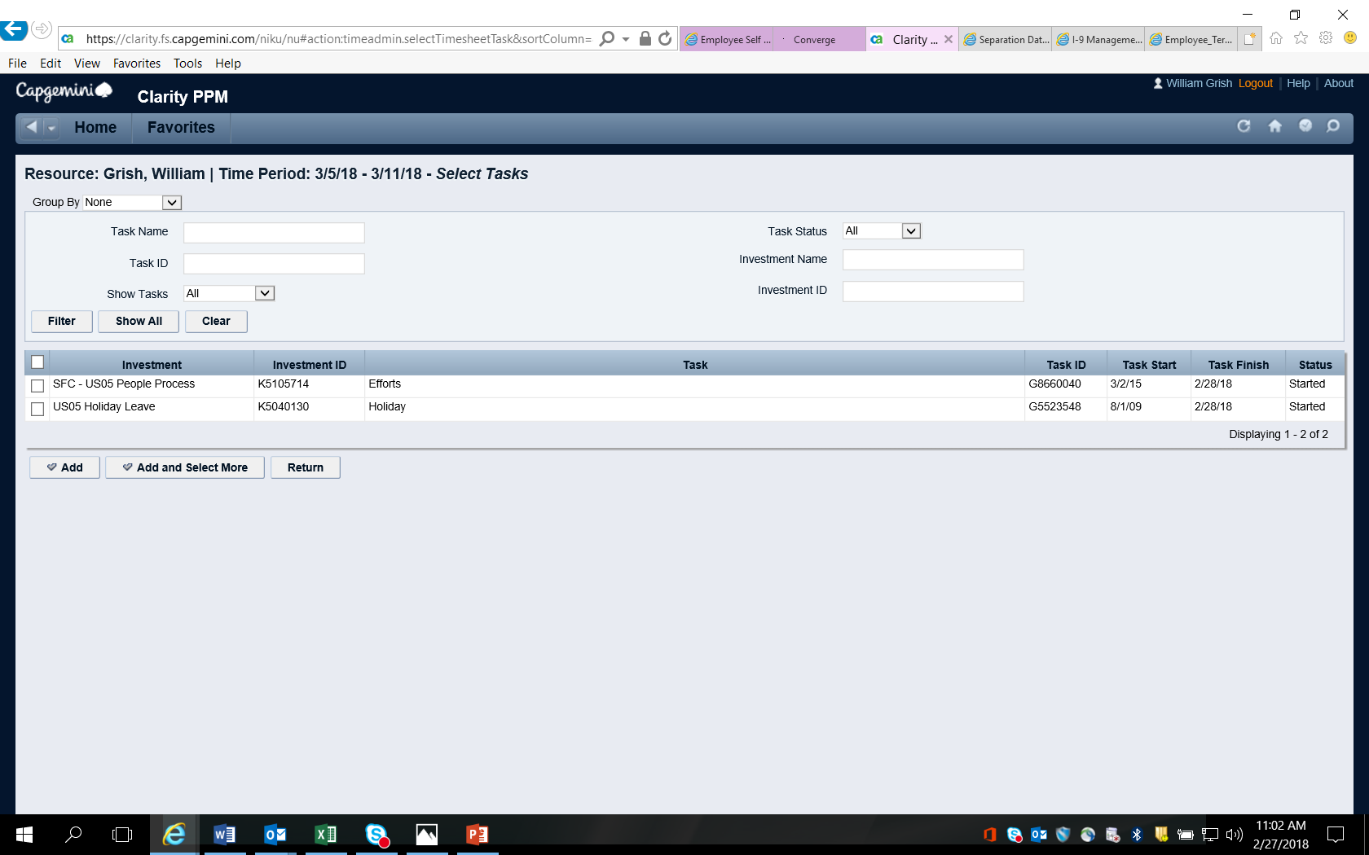
Timesheet Entry on Clarity (cont)
Verify your project and task codes. If you’re not able to see your codes click on the Show-All button. (If you still cannot view your projects or tasks, please contact your Staffing Partner
Note, the task finish date will always be the last day of the last month – this does not preclude you from entering time beyond this stated date.

Slide 40

Timesheet Entry on Clarity (cont)
To add a task, check the box next to the task and click ‘Add’. You can select any and all applicable tasks.

Slide 41
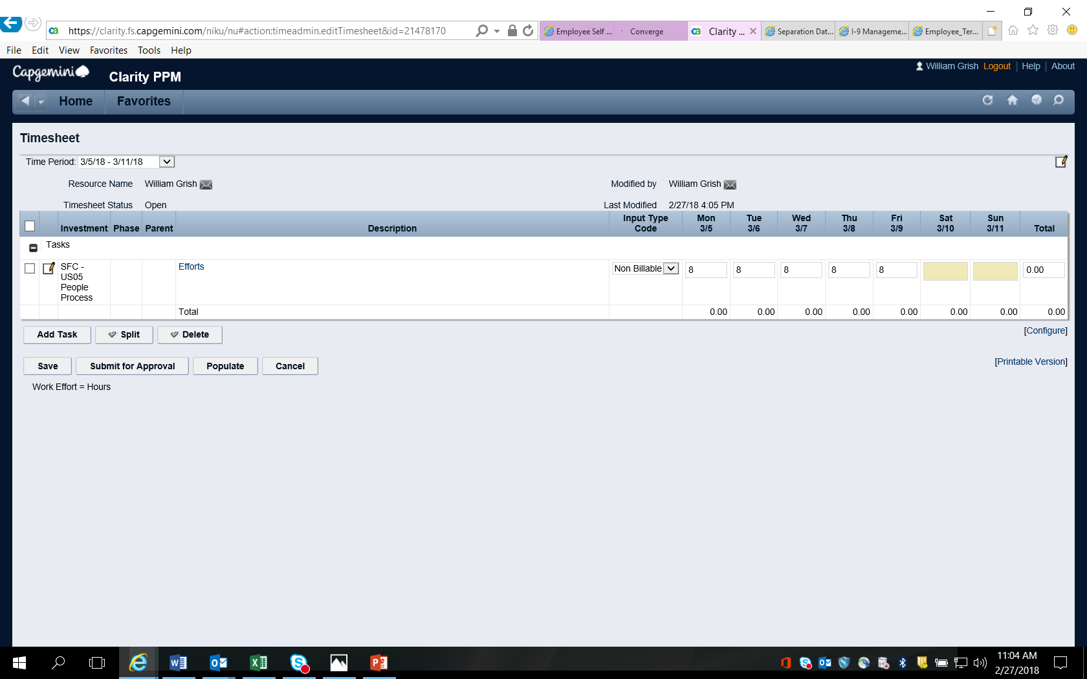
Timesheet Entry (cont)
You must enter all time or you will appear on the Missing Time report. It is expected that each complete week sum to 40 in the US. You must enter all time! That includes Holiday time for which there is a task that must be selected.
All time defaults to Billable. Change to Non Billable where appropriate!
Once you have entered all time for the week, click on ‘Submit for Approval’ button to submit the timesheet.

Slide 42
When Submitting Time Please Consider the Following….
Make sure you have entered all time and when you receive a note indicating that you have missing time, review all submitted timesheets to make sure that the sum to a total of 40 hours in NA for a five day work week.
Just because Holidays are shaded doesn’t mean you don’t have to enter time! You must enter a full day for all Holiday time.
Enter your time early, then adjust as needed. The majority of our timesheets don’t change through the course of the month. It is easier to enter on the 1st of the month and then make adjustments then to wait and find you have issues.
If you do make adjustments via the Leave Management System you must re-submit your timesheets in Clarity. The time from LMS will auto-populate in many cases, but it will not adjust previously entered time. An action is required in Clarity.
Occasionally timesheets for a week consist of only weekend dates (e.g. a month begins on a Sunday). There is no need to enter time against these timesheets unless you actually worked on those weekend days. These timesheets will ultimately be eliminated from your queue and do not result in a missing time result.

Slide 43
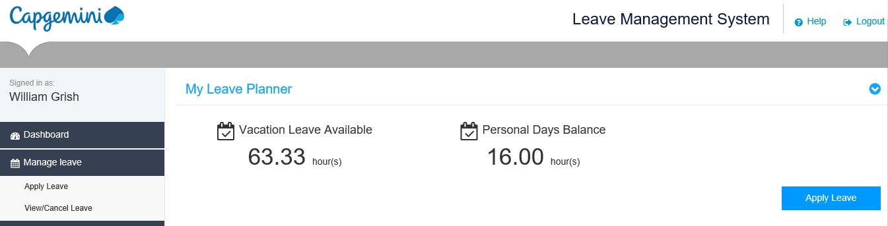
Leave Management System
Accessed only through IConnect
Planning of leaves in advance
Approval/Rejection by Supervisor
Access to leave information and history
Leave application and approval
Reports which can be used by employees/supervisors/support teams

